Slide 1

Stock Price Prediction
Present by
Jes Colbourne
Data Science & AI Program
Institute of Data

Slide 2
AGENDA
High value investors

Slide 3
BIOGRAPHY
High value investors

Slide 4
Project Context
High value investors

Slide 5


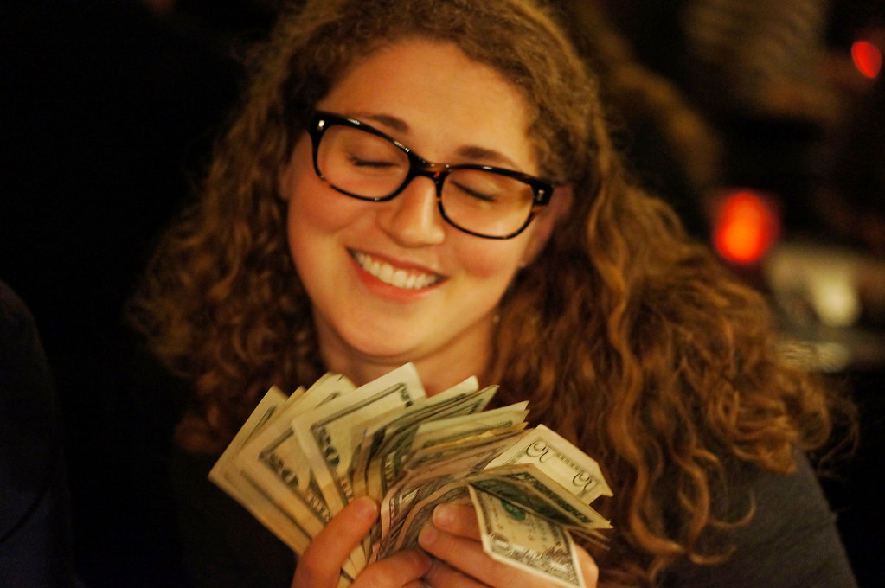
ASX Australian Investor Study 2020
High value investors
45% are women
Next generation investor
from the age of 18

Slide 6
ASX Australian Investor Study 2020
Number of investors remained stable over the past 15 years
41% invest under $100k and 26% invest between $100k-$500k

Slide 7
ASX Australian Investor Study 2020
65% consider potential return on investment
86% invested within personal capacity

Slide 8


ASX Australian Investor Study 2020
41% prefer to receive investor education via YOUTUBE

Slide 9
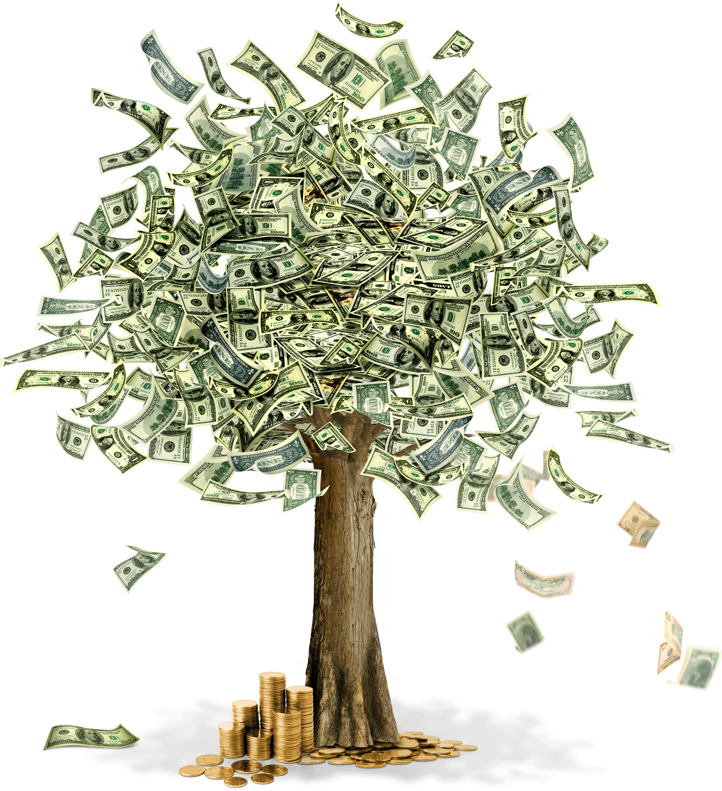
Business question
How to increase investment returns in stock market?

Slide 10
Dataset

Slide 11
Data pipeline
Data Acquisition
Data Pre-Processing
Data Integration
Model Selection
Training
Comparison
Validation
Deployment
Decision Making
Evaluation

Slide 12
Dataset
Commonwealth Bank of Australia stock price historical data from October 1991 to September 2022

Slide 13
Dataset

Slide 14
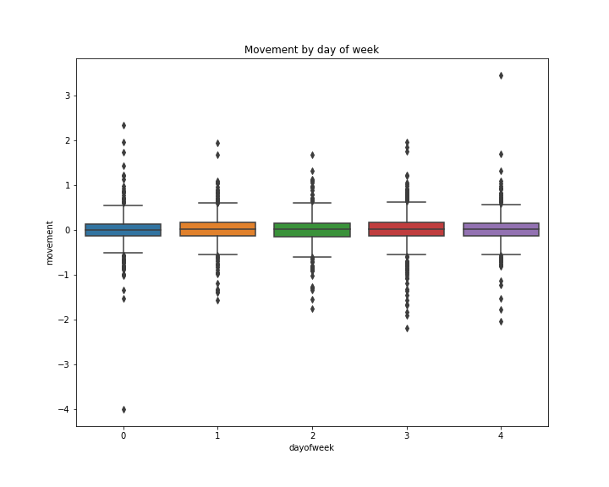
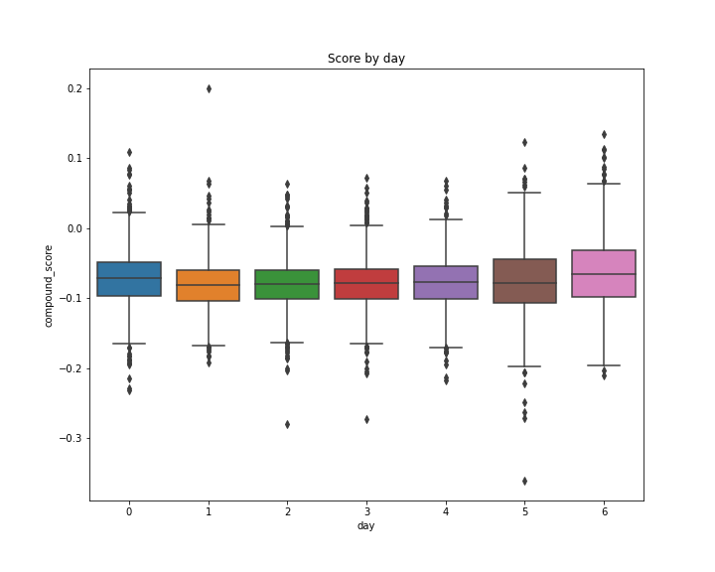
Dataset

Slide 15
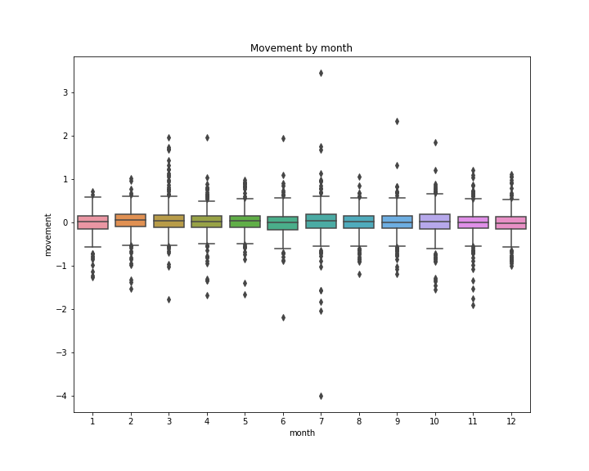
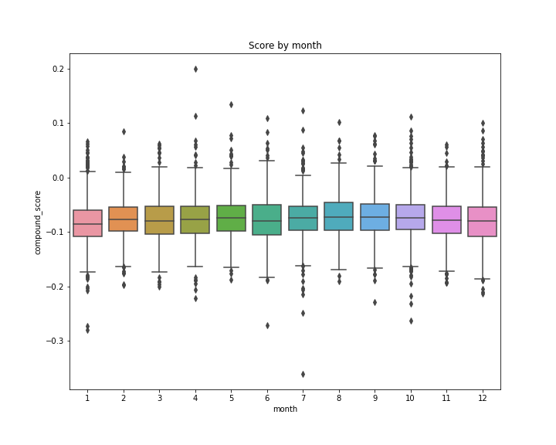
Dataset

Slide 16
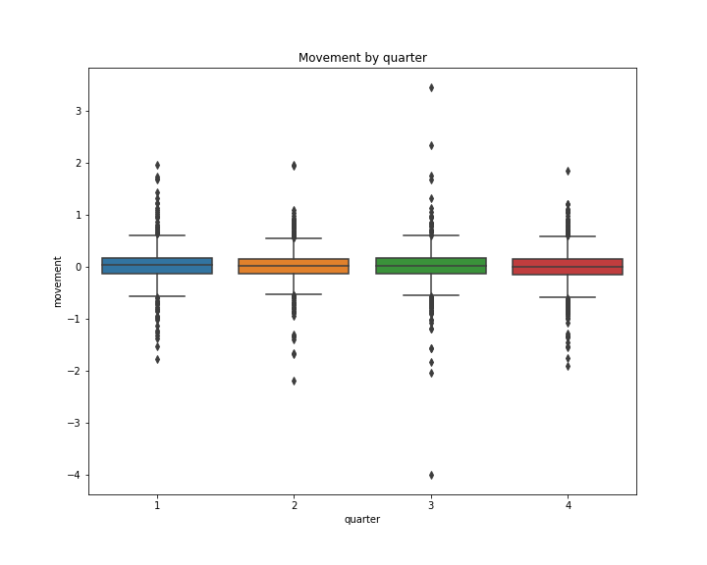
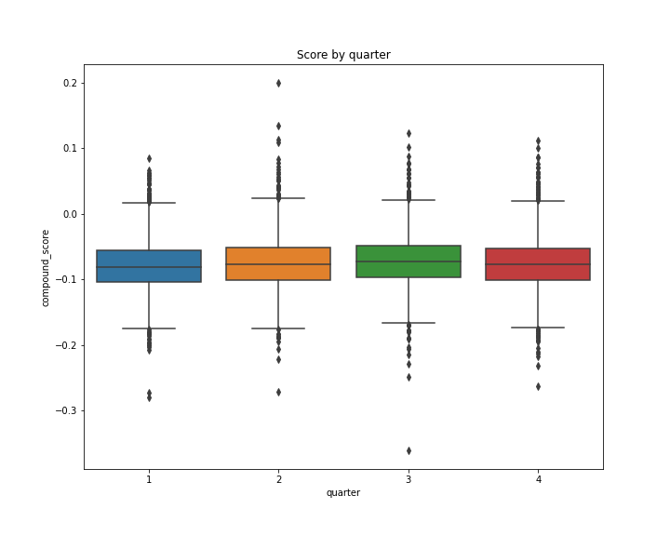
Dataset

Slide 17
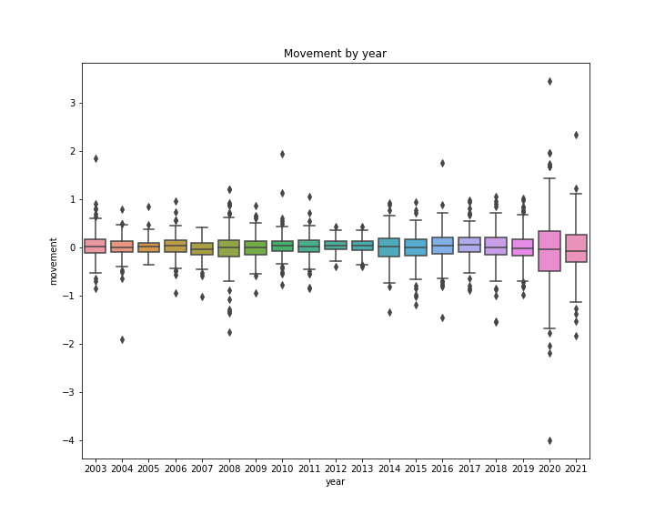
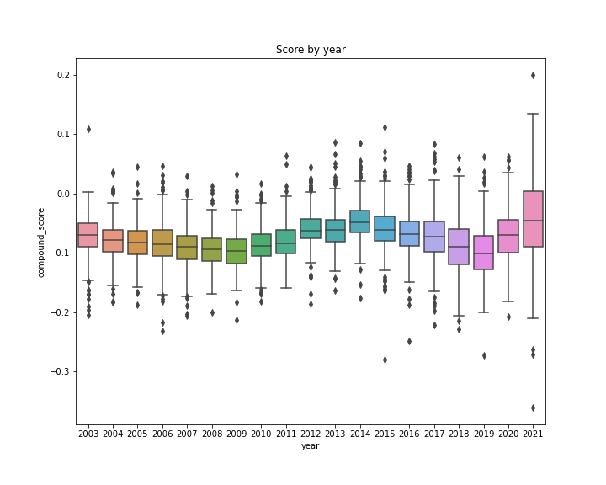
Dataset

Slide 18
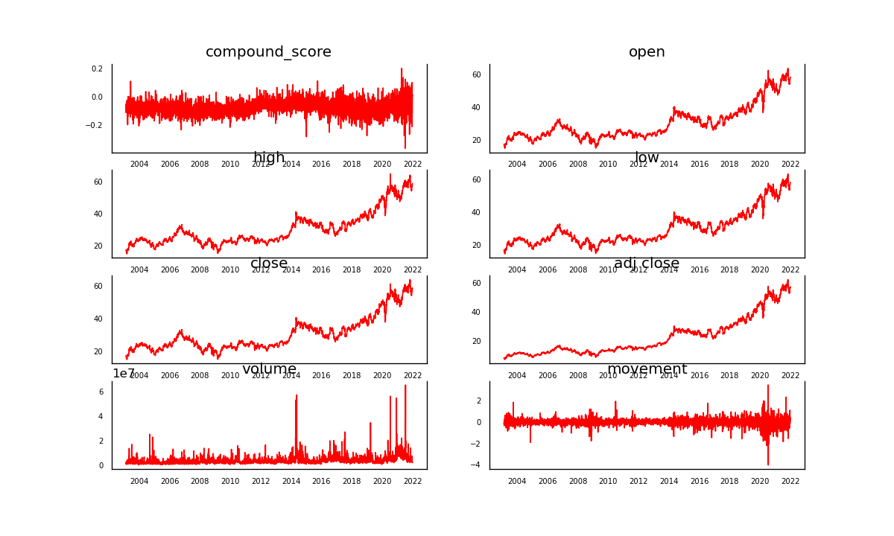
Dataset

Slide 19
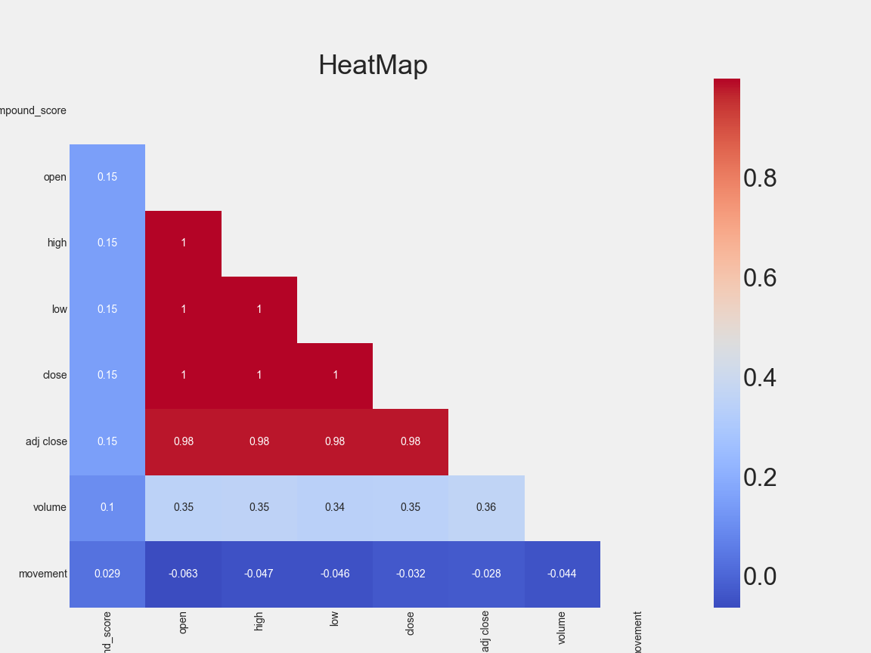
Dataset

Slide 20
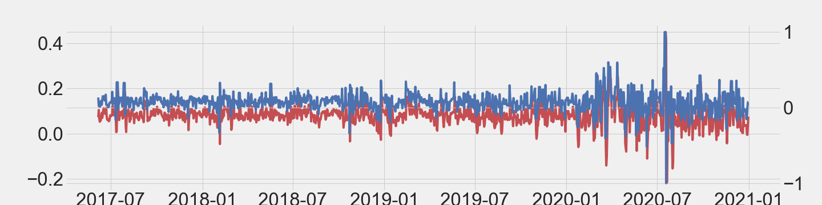
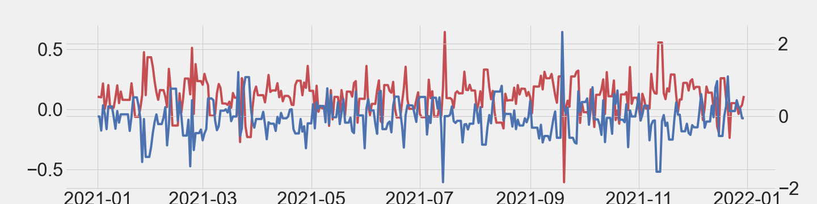
Model results: With Sentiment Score
Best model: ARIMA (2, 1, 2)
Test set
RMSE: 0.121
Test set
RMSE: 0.565

Slide 21

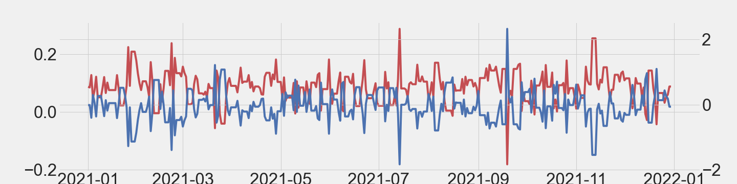
Model results: Without Sentiment Score
Best model: ARIMA (3, 1, 1)
Test set
RMSE: 0.121
Test set
RMSE: 0.543

Slide 22
Summary

Slide 23
Summary
Movement
Sentiment Score
Volume
Price

Slide 24
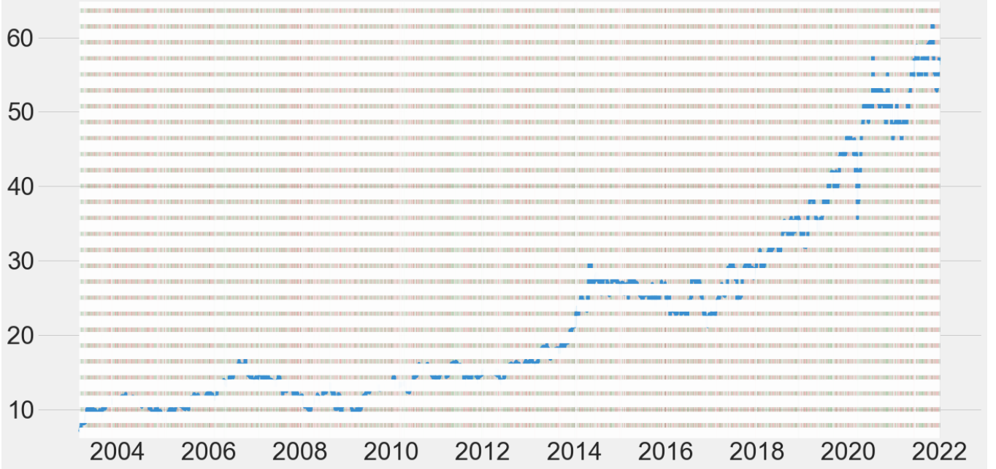
Trading Simulation: Base model ARIMA (3, 1, 1)
Random buying: AZN stocks with $1,000 investment
Results:
Total value $3,079.59
Total return 207.96%

Slide 25
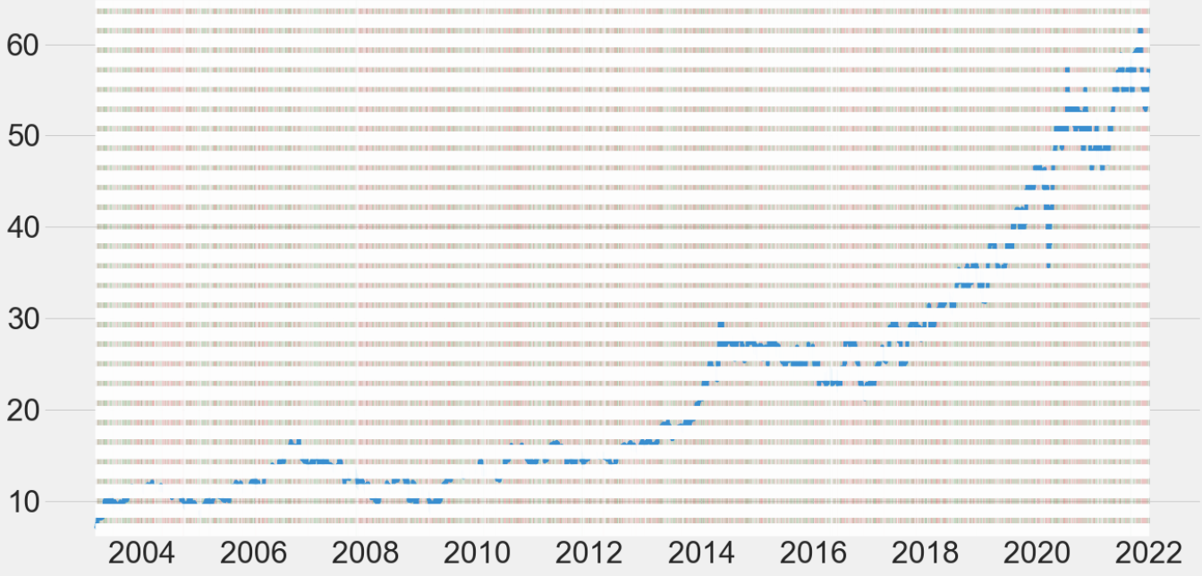
Trading Simulation: Base model ARIMA (3, 1, 1)
Buy if last return was positive: AZN stocks with $1,000 investment
Results:
Total value $636.88
Total return
-36.31%

Slide 26
Model results: Qantas

Slide 27
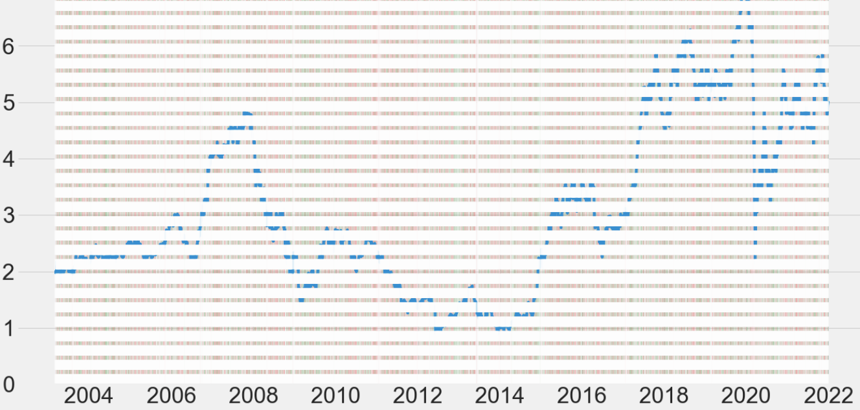
Trading Simulation: Base model ARIMA (3, 1, 1)
Random buying: QAN stocks with $1,000 investment
Results:
Total value
$806.18
Total return
-19.38%

Slide 28
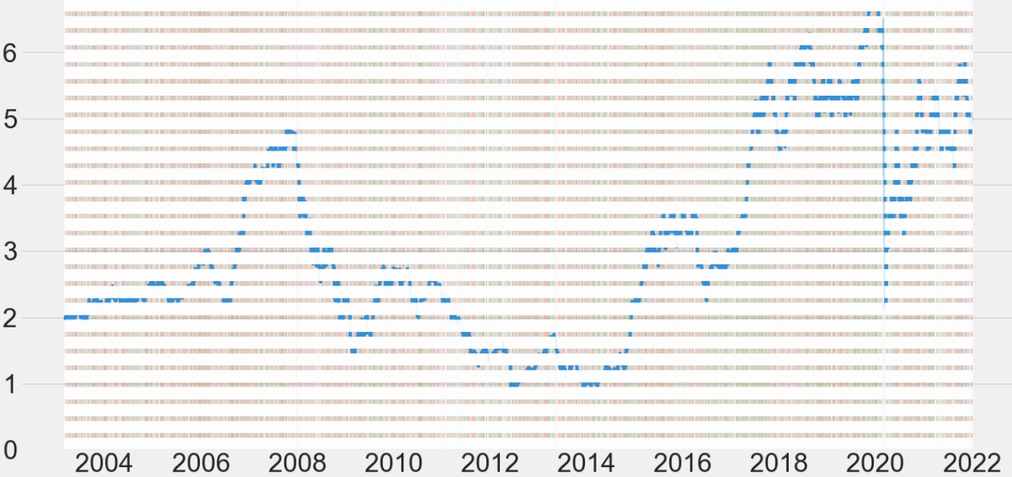
Trading Simulation: Base model ARIMA (3, 1, 1)
Buy if last return was positive: QAN stocks with $1,000 investment
Results:
Total value $1,348.64
Total return
34.86%

Slide 29
Next steps
1. Study the basics of the market that you are going to trade in
2. Technical analysis
3. Strategy
4. Backtest - rules based and has to be profitable
5. Optimize - best currenty pair, stop, target, risk-reward ratio, when the strategy work best
6. Risk management plan - managing the loss, keep you out of emotion when trade
7. Demo Trading
8. Discipline - don't gamble

Slide 30

Thank you ☺
-The End -

